Slide 1

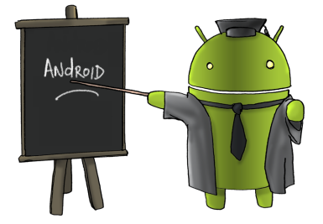
INTRODUCTION
Burhan Alfironi Muktamar, S.Kom., M.Eng.

Slide 2
Outline
Intro to Android Platform
Mobile Application Development
Android Application for Growth in Business
Development Tools
Hello Android Live Demo
Publishing Your App

Slide 3
Outline
Intro to Android Platform
Mobile Application Development
Android Application for Growth in Business
Development Tools
Hello Android Live Demo
Publishing Your App

Slide 4
What is Android?
Software stack for Mobile Devices.
Open source project.
Open handset alliance.

Slide 5
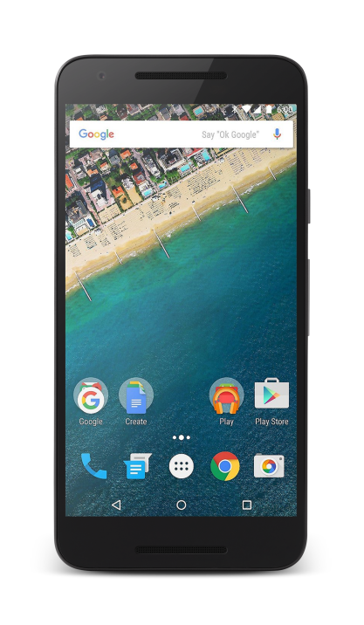
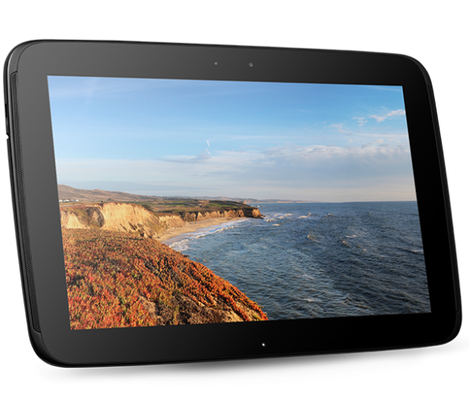
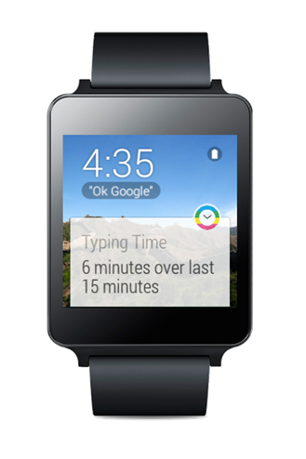
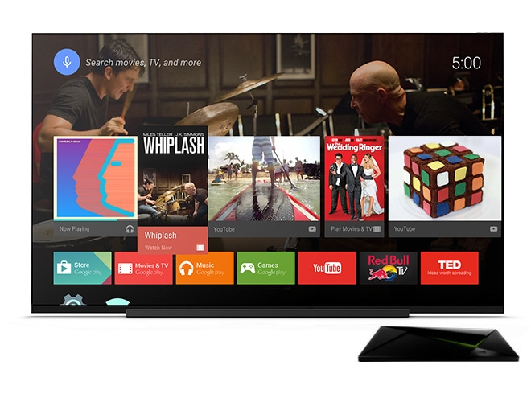
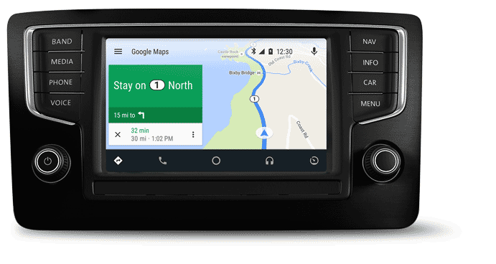
Handphone
Tablet
Wear
TV
Auto

Slide 6

Version Android
1.1 : February 9, 2009
Message
Alarm
Clock
Voice Search
Gmail
Browser

Slide 7

Cupcake
1.5 : April 27, 2009
Youtube
Picasa
Bluetooth A2Dp

Slide 8

Donut
1.6 : September 15, 2009
Quick search box
Screen size diversity
Android market

Slide 9
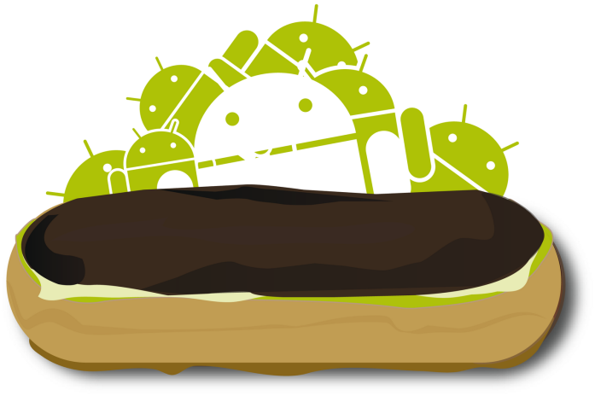
Eclair
2.1 : October 26, 2009
Google maps navigation
Home screen customization
Speech to text

Slide 10

Froyo
2.2 : May 20, 2010
Voice actions
Portable hotspot
Performance

Slide 11

Gingerbeard
2.3 : December 6, 2010
Gaming APIS
NFC (Near Field Communication)
Battery management

Slide 12

Honeycomb
3.0 : February 22, 2011
Tablet friendly design
System bar
Quick settings

Slide 13

Ice Cream Sandwich
4.0 : October 18, 2011
Custom home screen
Data usage control
Android beam

Slide 14
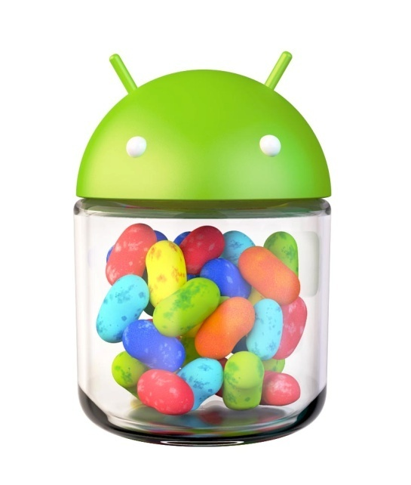
Jelly Bean
4.1 : July 9, 2012
Google now
Actionable notifications
Account switching

Slide 15

Kitkat
4.4 : October 31, 2013
Voice : ok google
Immersive design
Smart dialer

Slide 16

Lollipop
5.0 : November 12, 2014
Material design
Multiscreen
Notifications

Slide 17

Marshmallow
6.0 : October 5, 2015
Now on tap
Permissions
Battery

Slide 18
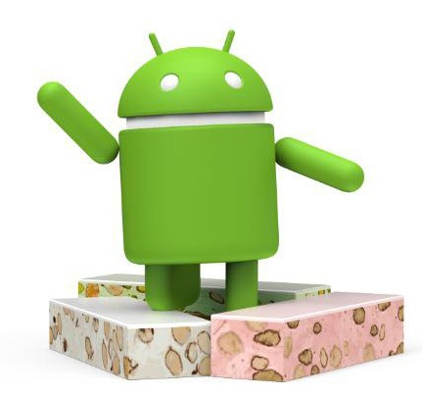
Nougat
7.0 : August 22, 2016
The OS that speaks your languages
Be in two places at once
With virtual reality mode
Quick switch between apps
Security
Notification Direct Reply

Slide 19
Outline
Intro to Android Platform
Mobile Application Development
Android Application for Growth in Business
Development Tools
Hello Android Live Demo
Publishing Your App

Slide 20

Android Feature
Animation and graphics
Computation
Media and camera
Location and sensors
Connectivity
Text and input
Data storage
Administration
Web apps

Slide 21
Outline
Intro to Android Platform
Mobile Application Development
Android Application for Growth in Business
Development Tools
Hello Android Live Demo
Publishing Your App

Slide 22
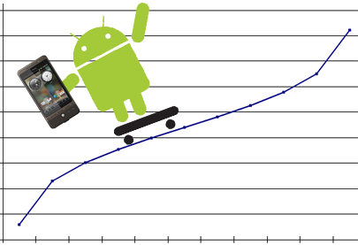
Growth Your Business

Slide 23


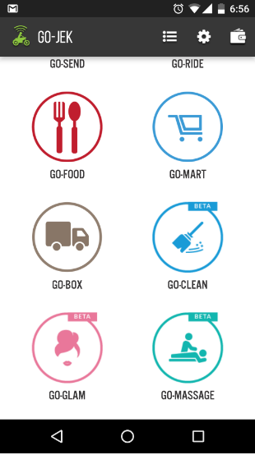
Android App

Slide 24
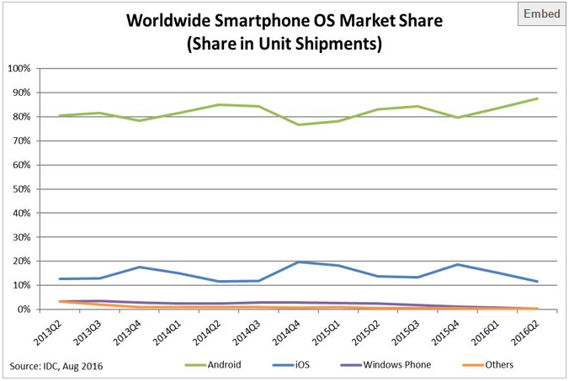
Android User

Slide 25
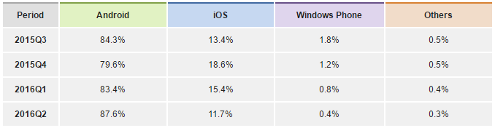
Android User

Slide 26

Business Intelligence
Track Page
Track Event
Track User Property

Slide 27
Outline
Intro to Android Platform
Mobile Application Development
Android Application for Growth in Business
Development Tools
Hello Android Live Demo
Publishing Your App

Slide 28

Development Tool
Android Studio
SDK Tools
Android Virtual Device

Slide 29
Outline
Intro to Android Platform
Mobile Application Development
Android Application for Growth in Business
Development Tools
Hello Android Live Demo
Publishing Your App

